Slide 1
DEEP LEARNING – BASED BIOLOGICAL SIGNAL STEGANOGRAPHY WITH MISSING DATA RECOVERY APPROACH
MEMBERS:
EKANATHAN S A (202006018)
SAIVIJAY S (202006038)
RAJASEKAR M (202006253)
GUIDE: Dr.G.YOGARAJAN, ME, PhD

Slide 2
AIM
To develop a robust system for encryption and decryption of bio-signal with a focus on lost-data recovery using Deep Learning techniques.
Notes:
2

Slide 3
PROBLEM
Sometimes, the bio-signals may get lost or tampered with during transmission.
SOLUTION
Reconstruction of lost bio-signal with the help of a deep learning approach.

Slide 4
ACRONYMS
PSO – Particle Swarm Optimization
HOA – Hippopotamus Optimization Algorithm
LSTM – Long Short Term Memory
MLPNN – Multi-Layer Perceptron Neural Network
PPG – PhotoPlethysmoGraph
EEG – ElectroEncephaloGraph
ECG – ElectroCardioGraph

Slide 5
OBJECTIVE
To implement a bio-signal encryption process using secret bit insertion.
To design a decryption mechanism secret bit extraction for bio-signal recovery.
To apply HOA algorithm to optimize the position and feature extraction of missed data blocks.
To integrate LSTM and MLPNN to reconstruct missing data blocks during transmission errors.
Notes:
5

Slide 6
NOVELTY
Generation of new Hermite functions
Utilization of hash functions for robust password generation and security enhancement.
Implementation of Hippopotamus Optimization Algorithm for block position optimization.
Integration of arrhythmia detection algorithms for early diagnosis in healthcare systems.
Notes:
6

Slide 7
LITERATURE SURVEY ON-DEVICE RELIABILITY ASSESSMENT AND PREDICTION OF
MISSING PHOTOPLETHYSMOGRAPHIC DATA USING
DEEP NEURAL NETWORKS
This paper presents an on-device reliability assessment for Photoplethysmographic (PPG) measurements in ambulatory subjects.
The methodology involves a stack denoising autoencoder (SDAE) and multilayer perceptron neural network (MLPNN) for reliability assessment, with missing segments predicted by a personalized convolutional neural network (CNN) and long-short term memory (LSTM) model.
The PPG Reliability Assessment Model (PRAM) achieves over 95% accuracy in identifying acceptable PPG beats, while the Missing Segment Prediction Model (MSPM) demonstrates effective prediction with a low root mean square error (RMSE) and mean absolute error (MAE).
The integrated device, based on ARM Cortex-A53, features 130 MB memory requirement and 0.35s latency per beat prediction.
M. S. Roy, B. Roy, R. Gupta, and K. D. Sharma, “On-device reliability assessment and prediction of missing photoplethysmographic data using deep neural networks,” IEEE Trans. Biomed. Circuits Syst., vol. 14, no. 6, pp. 1323–1332, Dec. 2020

Slide 8
LITERATURE SURVEY
ON-DEVICE RELIABILITY ASSESSMENT AND PREDICTION OF
MISSING PHOTOPLETHYSMOGRAPHIC DATA USING
DEEP NEURAL NETWORKS
ADVANTAGES:
High Accuracy in Reliability Assessment: The PPG Reliability Assessment Model (PRAM) achieves over 95% accuracy in correctly identifying acceptable PPG beats.
Low Latency and Memory Requirements: The device exhibits low latency and has relatively modest memory requirements, making it efficient and feasible for real-time applications.
DISADVANTAGES:
Discrepancy with Expert Annotations: Despite achieving high accuracy, there is a 3.5% disagreement with expert annotations in identifying acceptable PPG beats.
Limited Historical Data for Missing Segment Prediction.
M. S. Roy, B. Roy, R. Gupta, and K. D. Sharma, “On-device reliability assessment and prediction of missing photoplethysmographic data using deep neural networks,” IEEE Trans. Biomed. Circuits Syst., vol. 14, no. 6, pp. 1323–1332, Dec. 2020

Slide 9
LITERATURE SURVEY SVD-BASED ROBUST IMAGE STEGANOGRAPHIC SCHEME USING RIWT AND DCT FOR SECURE TRANSMISSION OF MEDICAL IMAGES
In this methodology, the Redundant Integer Wavelet Transform (RIWT) is applied for shift-invariant.
Image encryption is achieved using the logistic chaotic map.
Singular Value Decomposition (SVD) and Discrete Cosine Transform (DCT) are combined to optimize imperceptibility.
This comprehensive approach addresses both security and perceptibility concerns in the context of data communication, offering a superior solution.
S. Arunkumar, V. Subramaniyaswamy, V. Vijayakumar, N. Chilamkurti, and R. Logesh, “SVD-based robust image steganographic scheme using RIWT and DCT for secure transmission of medical images,” Measurement, vol. 139, pp. 426–437, Jun. 2019

Slide 10
LITERATURE SURVEY SVD-BASED ROBUST IMAGE STEGANOGRAPHIC SCHEME USING RIWT AND DCT FOR SECURE TRANSMISSION OF MEDICAL IMAGES
ADVANTAGES
Better level of imperceptibility was achieved using SVD and DCT, with embedding carried out on singular values.
Extra security was provided using the logistic chaotic map for encryption of secret medical images, which also enhanced the robustness of the technique
LIMITATIONS
DCT it does not localize the frequency components in space.
S. Arunkumar, V. Subramaniyaswamy, V. Vijayakumar, N. Chilamkurti, and R. Logesh, “SVD-based robust image steganographic scheme using RIWT and DCT for secure transmission of medical images,” Measurement, vol. 139, pp. 426–437, Jun. 2019

Slide 11
LITERATURE SURVEY SECURING DATA IN INTERNET OF THINGS (IOT) USING CRYPTOGRAPHY AND STEGANOGRAPHY TECHNIQUES
The approach in this IoT security-focused paper involves employing Elliptic Galois Cryptography to encrypt confidential medical data from diverse sources.
Subsequently, a Matrix XOR encoding steganography technique is utilized to embed the encrypted data into a visually simple image.
To optimize the selection of cover blocks within the image, an Adaptive Firefly optimization algorithm is applied.
M. Khari, A. K. Garg, A. H. Gandomi, R. Gupta, R. Patan, and B. Balusamy, “Securing data in Internet of Things (IoT) using cryptography and steganography techniques,” IEEE Trans. Syst., Man, Cybern., Syst., vol. 50, no. 1, pp. 73–80, Jan. 2020

Slide 12
LITERATURE SURVEY SECURING DATA IN INTERNET OF THINGS (IOT) USING CRYPTOGRAPHY AND STEGANOGRAPHY TECHNIQUES
ADVANTAGES
Image steganography has a high capacity to carry secret information as it can hide a large amount of data within an image.
Image steganography provides a covert means of communication, as the existence of the secret message is hidden within the image.
LIMITATIONS
Adaptive Firefly optimization algorithm may introduce complexity to the system.
M. Khari, A. K. Garg, A. H. Gandomi, R. Gupta, R. Patan, and B. Balusamy, “Securing data in Internet of Things (IoT) using cryptography and steganography techniques,” IEEE Trans. Syst., Man, Cybern., Syst., vol. 50, no. 1, pp. 73–80, Jan. 2020

Slide 13
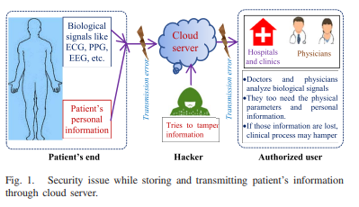


BLOCK DIAGRAM
Biological
Signal like
ECG, PPG,
EEG, etc.
Cloud
server
Cloud
server
Transmission error
Transmission error
Hospitals
and Clinics
Physicians
• Doctors and physicians analyze biological signals. • They too need the physical parameters and personal information. • If those information are lost, clinical process may hamper
Patient’s
Personal
information
Tries to tamper
information
Patient’s end
Hacker
Authorized user
﻿Fig. 1. Security issue while storing and transmitting patient's information through cloud server.

Slide 14
BLOCK DIAGRAM
ENCRYPTION: INSERTION OF SECRET BITS
DECRYPTION: EXTRACTION OF SECRET BITS
Transmission (with information loss in stego-data)
Reconstructed blocks
Bio-signal
Arrhythmia
B₁
B₂
B₃
B₄
n
Secret bit insertion in Hermite space
Predicted Missing block
Reconstructed Bio-signal
Passkey
Secret bit extraction in Hermite space
HO-Based
estimation
Yes
Secret-bit
Irregular
Heart beat
BT₁
BT₂
BT₃
BT₄
n
No
Su-LSTM
B`₁
B`₂
B`₃
B`₄
n
B`₁
B`₂
?
B`₄
n
Stego-data
Hash function
Yes
Equal
No
Hash function
Normal
X1
X2
X3
n-1
Password
X1
X2
X3
n-1
Password
Password
﻿Fig. 2.Block diagram of proposed steganography algorithm shown for both data insertion and extraction, mentioning data loss during transmission.

Slide 15
ENCRYPTION: INSERTION OF SECRET BITS

Slide 16
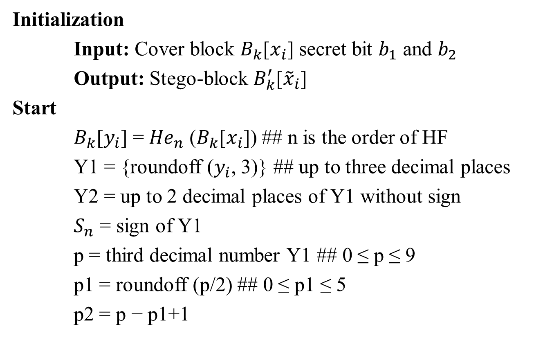
ALGORITHM 1 - Secret Bit Insertion in Hermite Space
Initialization
Input: Cover block $B_{k}$[$x_{i}$] secret bit $b_{1}$ and $b_{2}$
Output: Stego-block $B_{k}^{′}$[${\tilde{x}}_{i}$]
Start
$B_{k}$[$y_{i}$] = ${He}_{n}$ ($B_{k}$[$x_{i}$]) ## n is the order of HF
Y1 = {roundoff ($y_{i}$, 3)} ## up to three decimal places
Y2 = up to 2 decimal places of Y1 without sign
$S_{n}$ = sign of Y1
p = third decimal number Y1 ## 0 ≤ p ≤ 9
p1 = roundoff (p/2) ## 0 ≤ p1 ≤ 5
p2 = p − p1+1

Slide 17
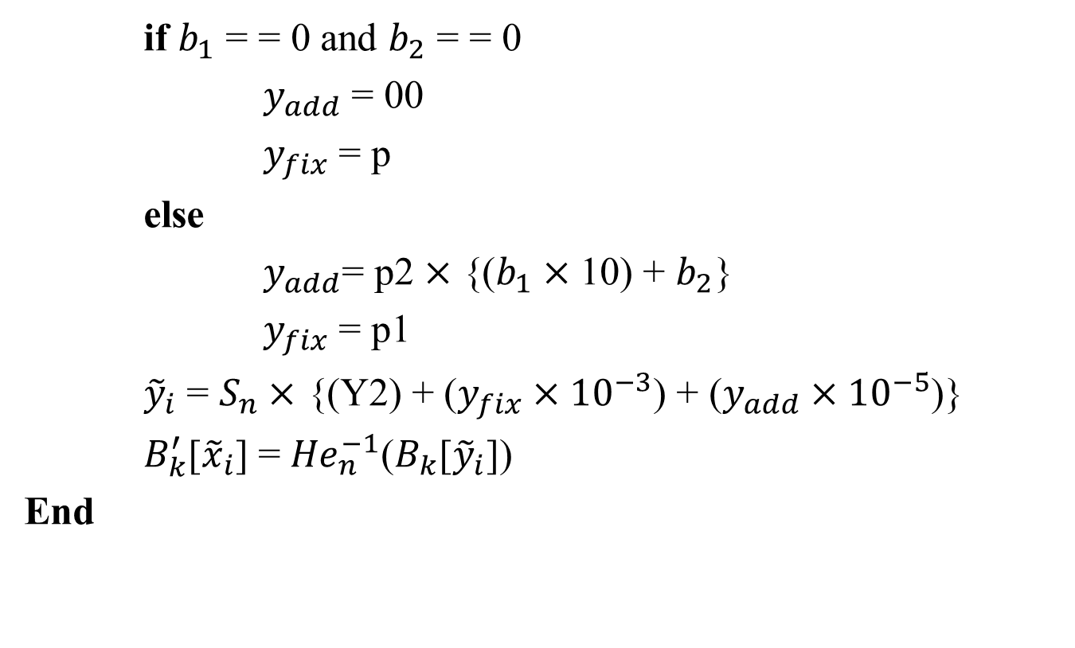
ALGORITHM 1 - Secret Bit Insertion in Hermite Space cont’d..
if $b_{1}$ = = 0 and $b_{2}$ = = 0
$y_{add}$ = 00
$y_{fix}$ = p
else
$y_{add}$= p2 $×$ {($b_{1}×$ 10) + $b_{2}$}
$y_{fix}$ = p1
${\tilde{y}}_{i}$ = $S_{n}×$ {(Y2) + ($y_{fix}×{10}^{−3}$) + ($y_{add}×{10}^{−5}$)}
$B_{k}^{′}$[${\tilde{x}}_{i}$] = ${He}_{n}^{−1}$($B_{k}$[${\tilde{y}}_{i}$])
End

Slide 18
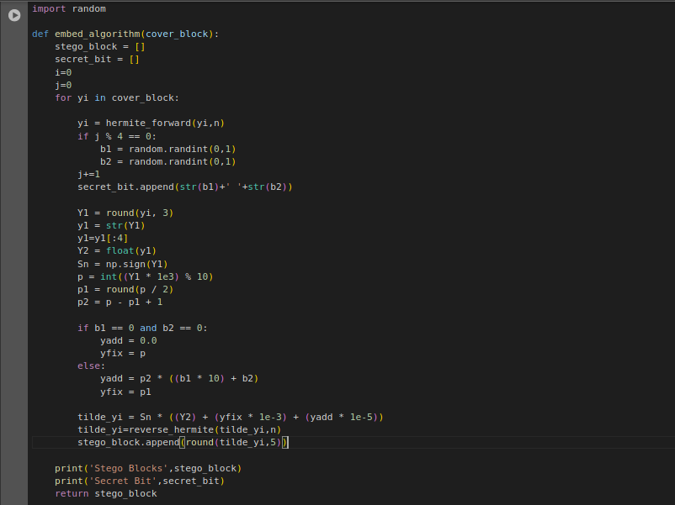
ALGORITHM 1

Slide 19
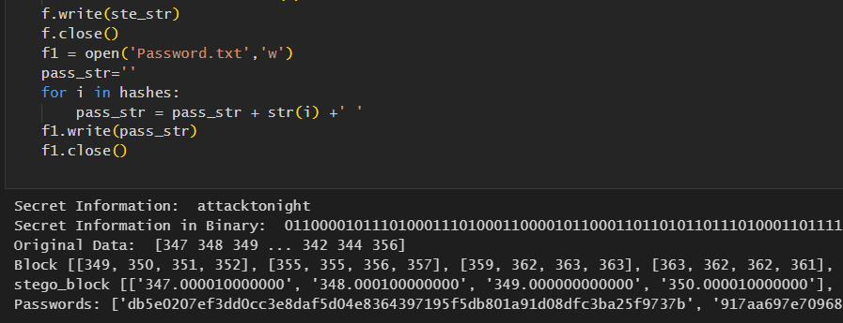
ENCRYPTION

Slide 20
DECRYPTION: EXTRACTION OF SECRET BITS

Slide 21
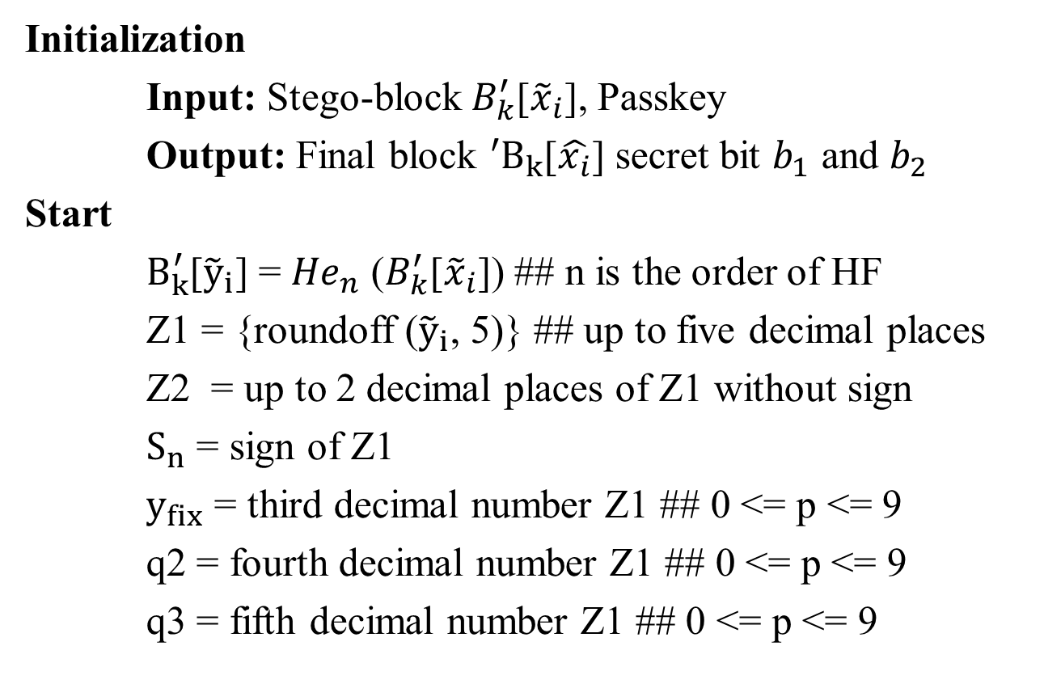
ALGORITHM 2 - Secret Bit Extraction in Hermite Space
Initialization
Input: Stego-block${ B}_{k}^{′}$[${\tilde{x}}_{i}$], Passkey
Output: Final block ${{}_{ }^{′}B}_{k}$[$\hat{x_{i}}$] secret bit $b_{1}$ and $b_{2}$
Start
$B_{k}^{′}$[${\tilde{y}}_{i}$] = ${He}_{n}$ ($B_{k}^{′}$[${\tilde{x}}_{i}$]) ## n is the order of HF
Z1 = {roundoff (${\tilde{y}}_{i}$, 5)} ## up to five decimal places
Z2 = up to 2 decimal places of Z1 without sign
$S_{n}$ = sign of Z1
$y_{fix}$ = third decimal number Z1 ## 0 <= p <= 9
q2 = fourth decimal number Z1 ## 0 <= p <= 9
q3 = fifth decimal number Z1 ## 0 <= p <= 9

Slide 22
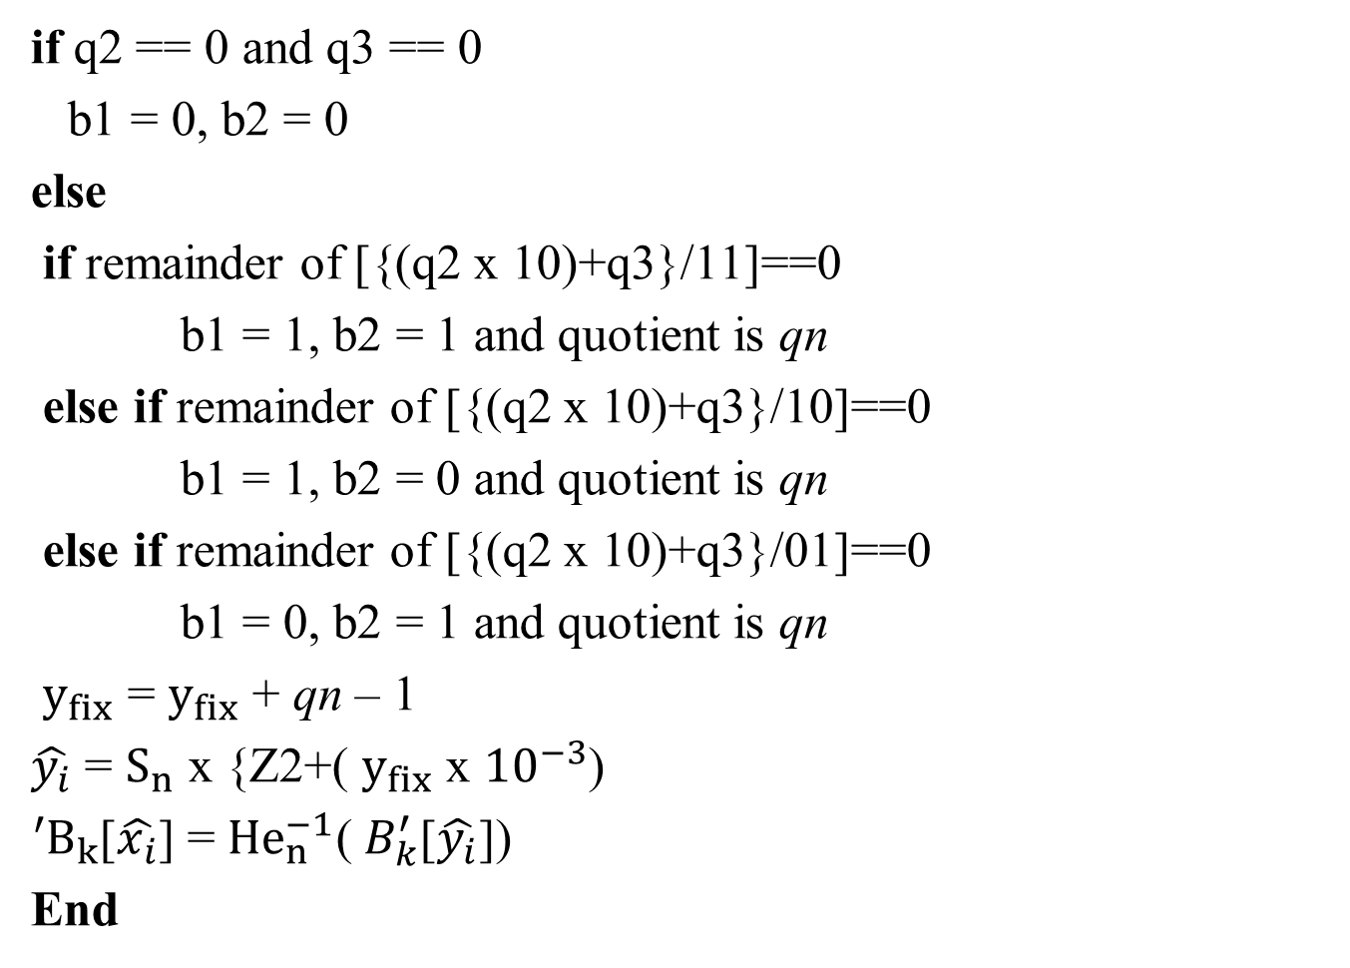
cont’d..
if q2 == 0 and q3 == 0
b1 = 0, b2 = 0
else
if remainder of [{(q2 x 10)+q3}/11]==0
b1 = 1, b2 = 1 and quotient is qn
else if remainder of [{(q2 x 10)+q3}/10]==0
b1 = 1, b2 = 0 and quotient is qn
else if remainder of [{(q2 x 10)+q3}/01]==0
b1 = 0, b2 = 1 and quotient is qn
$y_{fix}$ = $y_{fix}$ + qn – 1
$\hat{y_{i}}$ = $S_{n}$ x {Z2+( $y_{fix}$ x ${10}^{−3}$)
${{}_{ }^{′}B}_{k}$[$\hat{x_{i}}$] = ${He}_{n}^{−1}$(${ B}_{k}^{′}$[$\hat{y_{i}}$])
End

Slide 23
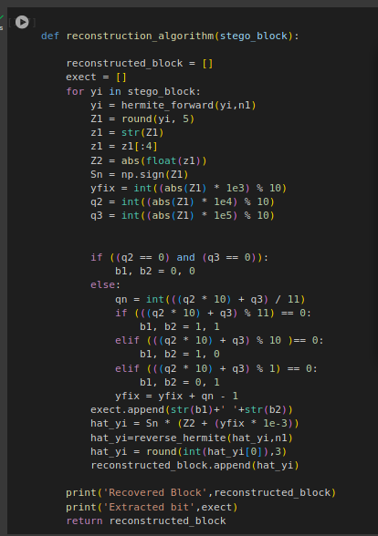
ALGORITHM 2

Slide 24
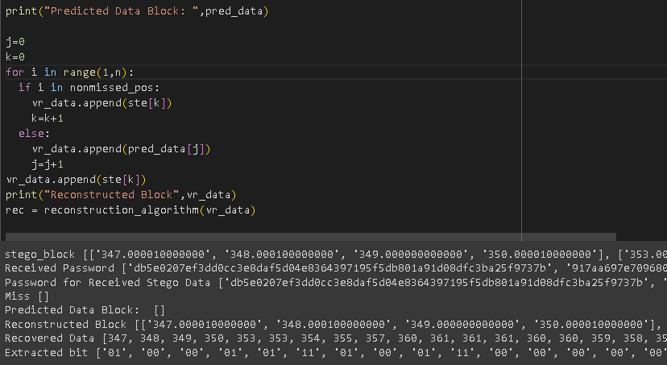
DECRYPTION – NO TAMPERING

Slide 25
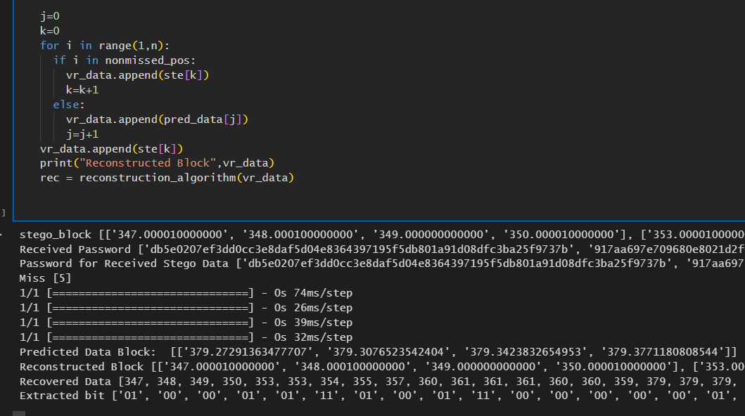
DECRYPTION – TAMPERING

Slide 26
Algorithm 3 - Hippopotamus Optimization (HO)
Inputs :
SearchAgents: Number of search agents (hippos) in the population.
Max_iterations: Maximum number of iterations.
lowerbound: Lower bounds for the search space.
upperbound: Upper bounds for the search space.
dimension: Dimensionality of the problem.
fitness: Objective function to be optimized.
Outputs :
Best_pos: Best solution found.
Best_score: Fitness value of the best solution.

Slide 27
Start
Initialization:
Define the levy flight function levy to generate levy flights.
Initialize population X with SearchAgents random solutions within the search space defined by lowerbound and upperbound.
Evaluate the fitness of each solution in X.
Main Loop:
Repeat for each iteration t in [1, Max_iterations]:
a. Record the best solution found so far (Xbest) and
its corresponding fitness (fbest).
b. Divide the population into two groups:
- Group 1: Hippos mimicking cooperative behavior.
- Group 2: Predators mimicking predatory behavior.

Slide 28
c. Update positions of solutions in Group 1 based on
cooperative behavior:
- Each solution explores using levy flights and interacts with a dominant hippopotamus and nearby group mean.
d. Update positions of solutions in Group 2 based on predatory behavior:
- Each solution imitates a predator, attempting to catch
its prey using levy flights and distance-based rules.
e. Apply local exploration to all solutions in the population:
- Perturb the positions of solutions using a randomized exploration strategy.

Slide 29
f. Update fitness values of all solutions.
g. Record the best solution found in this iteration.
Termination:
Return Best_pos, the corresponding Best_score
End

Slide 30
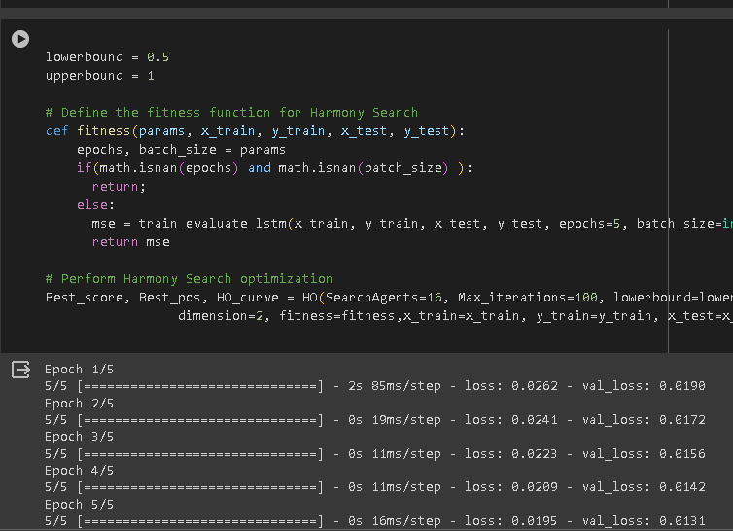
HOA – OPTIMIZATION

Slide 31
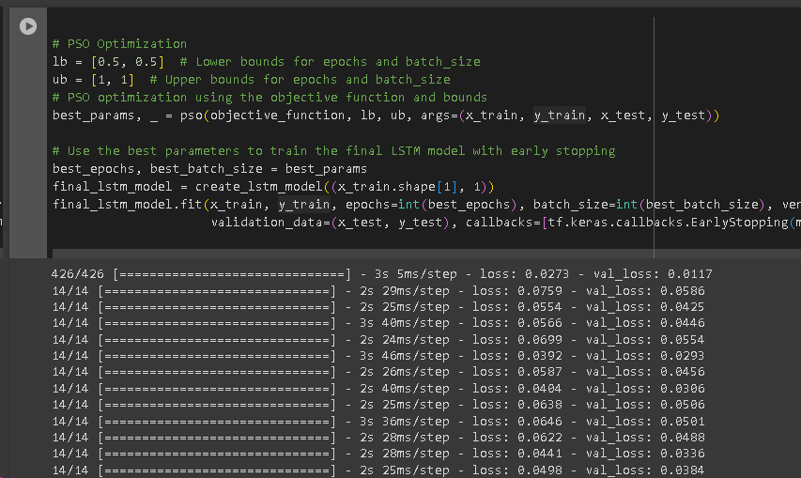
PSO – OPTIMIZATION

Slide 32
PREDICTION OF LOST STEGO-BLOCK USING SU-LSTM

Slide 33

ARCHITECTURE OF SU-LSTM NETWORK
Predicted block
B`₁
B`₂
?
B`₄
n
$$HOA$$
C_{t-1}
C_{t}
position
tanh
weights
V_{t-1}
F
I
U
O
_{Vt}
MLPNN
U_{t}
LSTM
B`₃

Slide 34
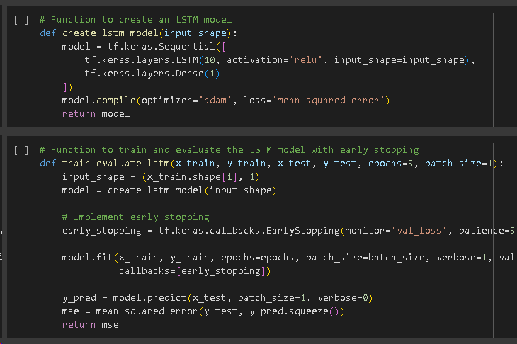
LSTM TRAINING

Slide 35
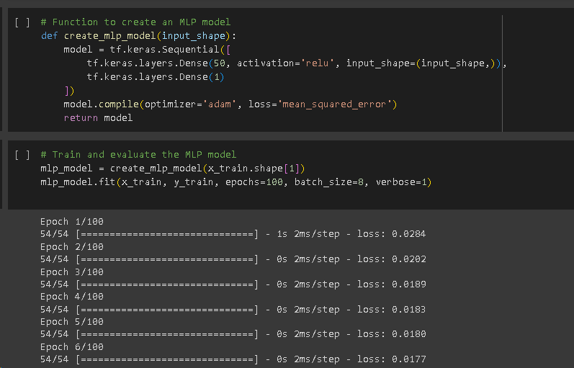
MLPNN MODEL

Slide 36
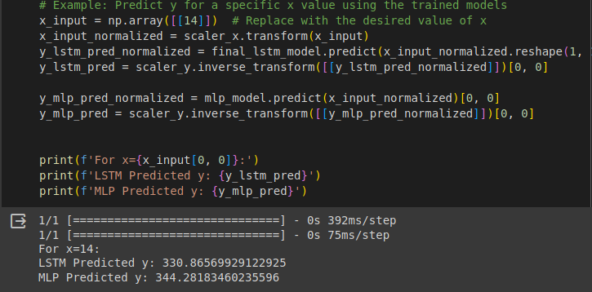
DATA PREDICTION - PSO

Slide 37
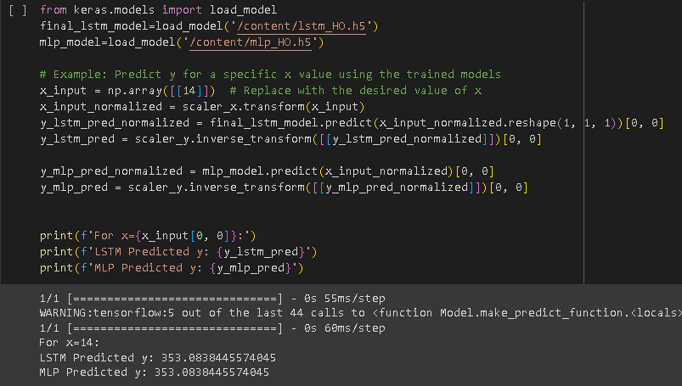
DATA PREDICTION - HOA

Slide 38
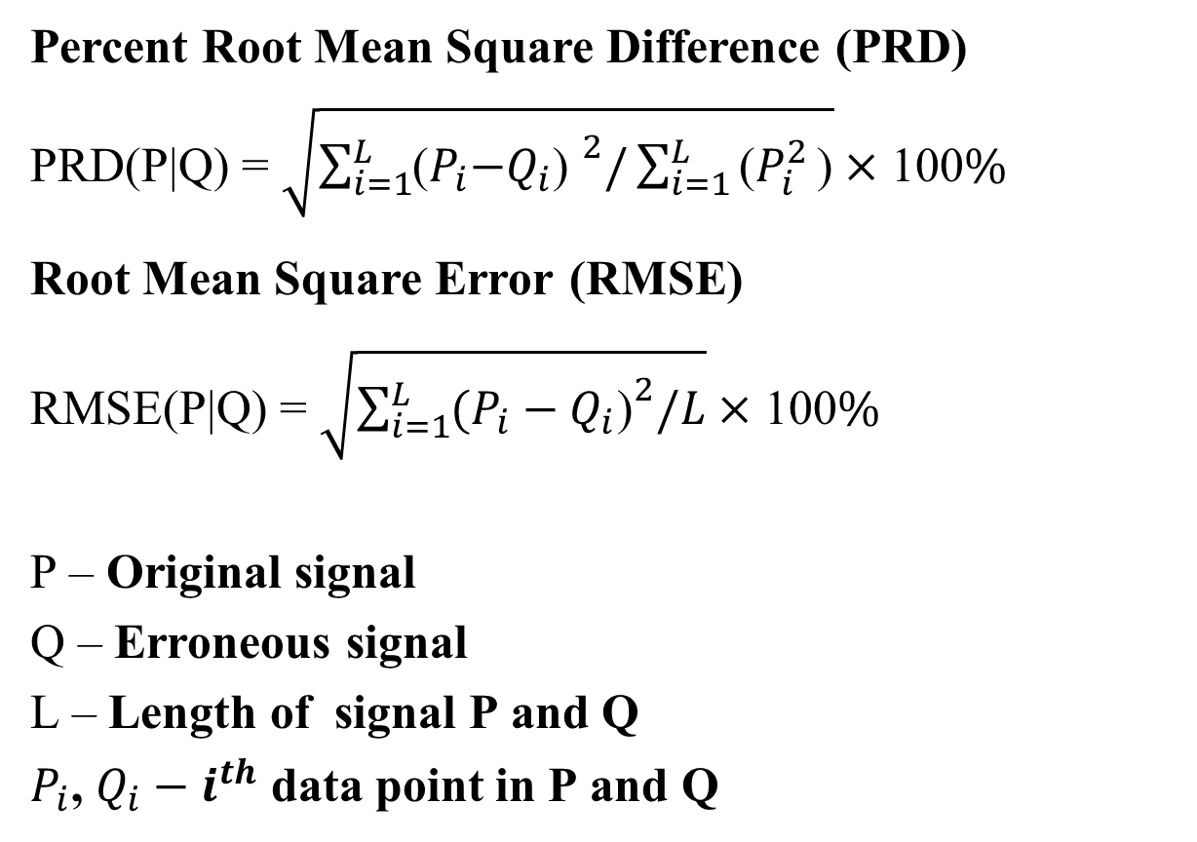
PERFORMANCE INDICES
Percent Root Mean Square Difference (PRD)
PRD(P|Q) = $\sqrt{\sum_{i=1}^{L}{{\text{(}P_{i}\text{−}Q_{i}\text{) }}^{2}/\sum_{i=1}^{L}{\text{(}P_{i}^{2}}}\text{)}}×$ 100%
Root Mean Square Error (RMSE)
RMSE(P|Q) = $\sqrt{\sum_{i=1}^{L}{{(P_{i}−Q_{i}\text{)}}^{2}/L}}×$ 100%
P – Original signal
Q – Erroneous signal
L – Length of signal P and Q
$P_{i}$, $Q_{i}−i^{th}$ data point in P and Q

Slide 39
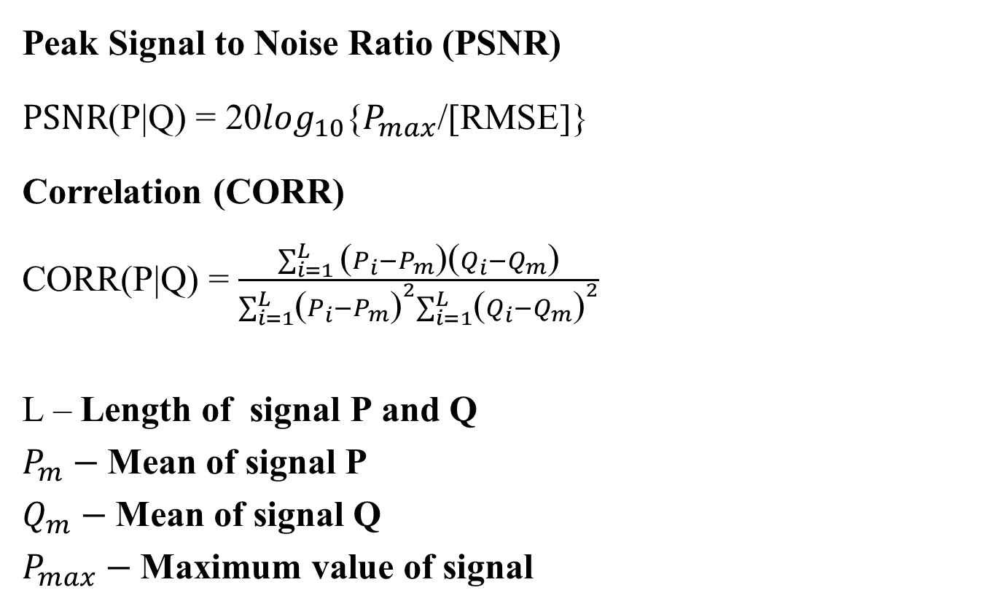
PERFORMANCE INDICES
Peak Signal to Noise Ratio (PSNR)
PSNR(P|Q) = 20$\log_{10}${$P_{max}$/[RMSE]}
Correlation (CORR)
CORR(P|Q) = $\frac{\sum_{i=1}^{L}{\text{(}P_{i}−P_{m}\text{)(}Q_{i}−Q_{m}\text{)}}}{\sum_{i=1}^{L}{{\text{(}P_{i}−P_{m}\text{)}}^{2}\sum_{i=1}^{L}{{\text{(}Q_{i}−Q_{m}\text{)}}^{2}}}}$
L – Length of signal P and Q
$P_{m}−$Mean of signal P
$Q_{m}−$Mean of signal Q
$P_{max}−$Maximum value of signal
=
1

Slide 40
EXPERIMENTAL RESULTS
ECG
 | Error between stego and Original data |  |  | Error between reconstructed and original data
No. of Secret bits | PRD | RMSE | PSNR | PRD | RMSE | PSNR
1000 | 0.00002 | 0.0005 | 113.95 | 0.000498 | 0.00013 | 114.168
2000 | 0.00002 | 0.0005 | 113.85 | 0.00014 | 0.00050 | 114.08
3000 | 0.00002 | 0.0005 | 113.60 | 0.000145 | 0.00051 | 113.87
EEG
 | Error between stego and Original data |  |  | Error between reconstructed and original data
No. of Secret bits | PRD | RMSE | PSNR | PRD | RMSE | PSNR
1000 | 0.000003 | 0.00076 | 110.50 | 0.000031 | 0.0007 | 110.97
2000 | 0.000003 | 0.0007 | 110.44 | 0.000031 | 0.00072 | 110.97
3000 | 0.000003 | 0.00077 | 110.29 | 0.000032 | 0.00073 | 110.82

Slide 41
EXPERIMENTAL RESULTS
PPG
 | Error between stego and Original data |  |  | Error between reconstructed and original data
No. of Secret bits | PRD | RMSE | PSNR | PRD | RMSE | PSNR
1000 | 0.000002 | 0.00075 | 110.52 | 0.00002 | 0.00071 | 111.038
2000 | 0.000002 | 0.00076 | 110.47 | 0.00002 | 0.00072 | 110.93
3000 | 0.000002 | 0.00074 | 110.73 | 0.00001 | 0.00069 | 111.234

Slide 42
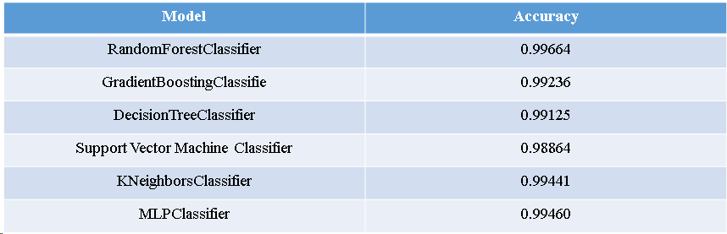
ARRHYTHMIA TRAINING MODEL RESULT
r

Slide 43
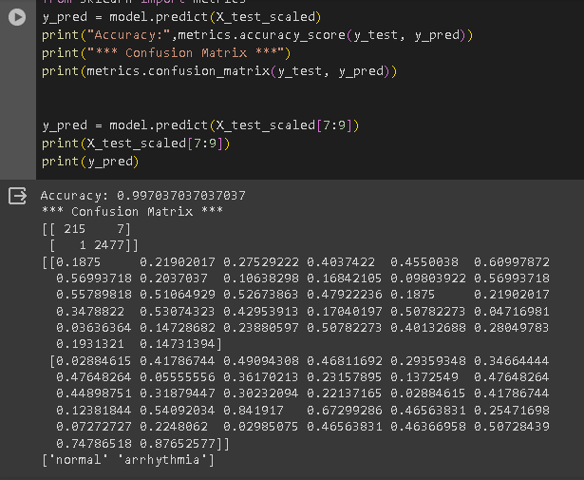
ARRHYTHMIA DETECTION

Slide 44
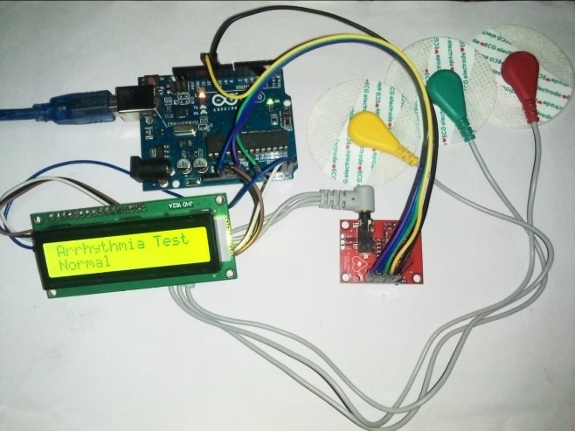
ARRHYTHMIA DETECTION - NORMAL

Slide 45
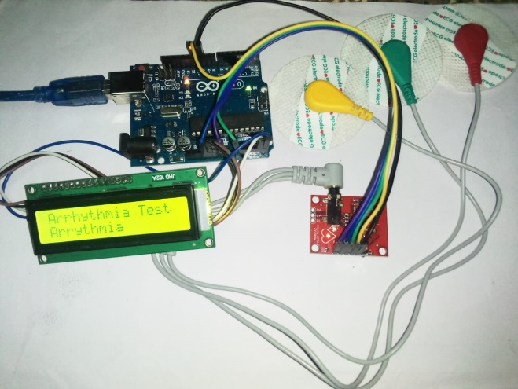
ARRHYTHMIA DETECTION - POSITIVE

Slide 46
DATA SET
ECG Dataset
ecg_data_t.csv
PPG Dataset
PPG_Data.csv
EEG Dataset
EEG_Data.csv

Slide 47
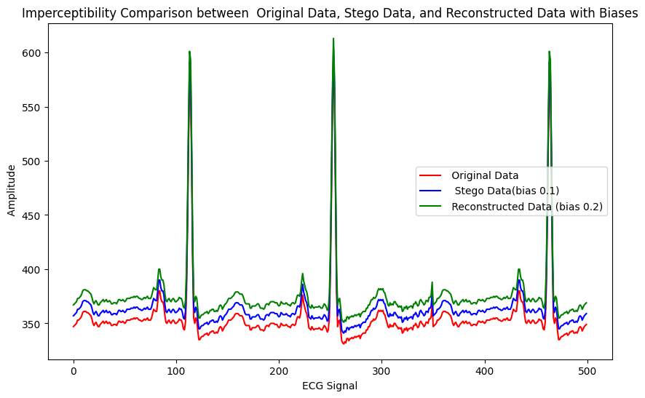
IMPERCEPTIBILITY – WITH OUT TAMPERING

Slide 48
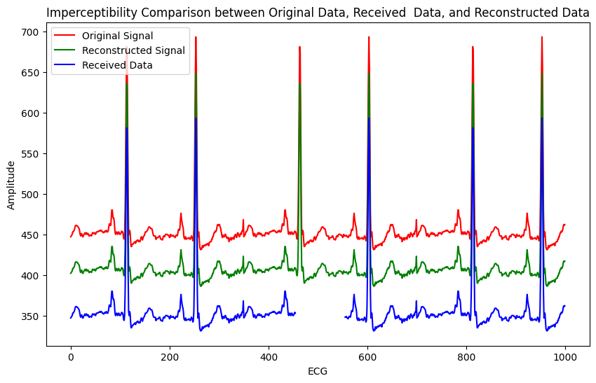
IMPERCEPTIBILITY – TAMPERED DATA

Slide 49
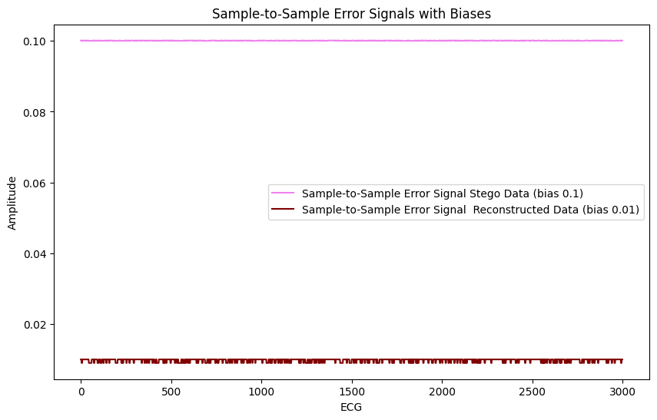
SAMPLE – SAMPLE ERROR

Slide 50
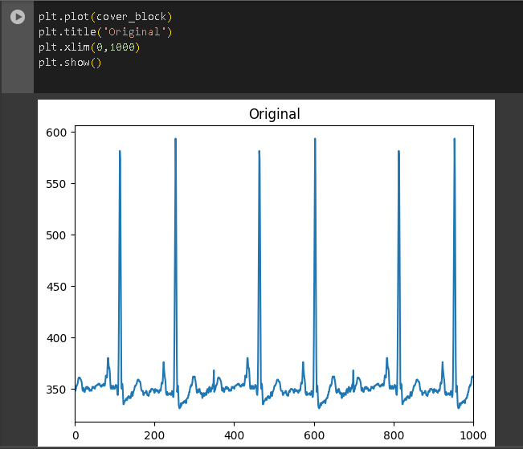
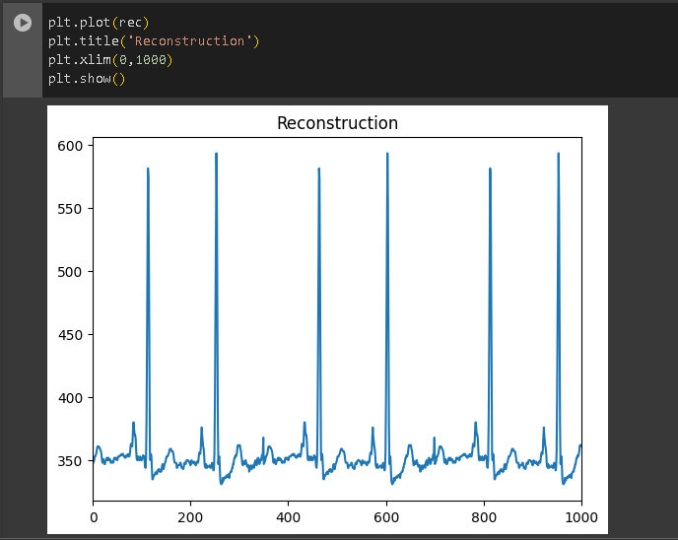
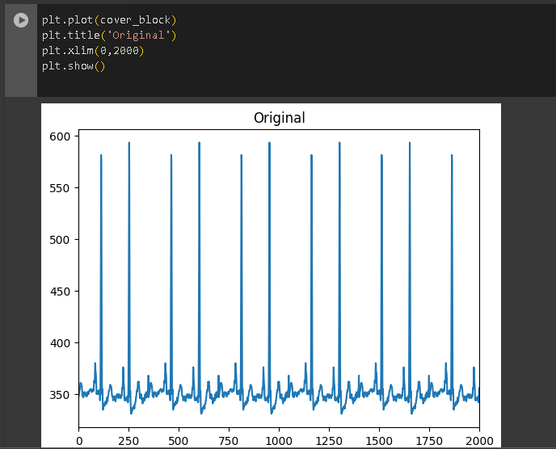
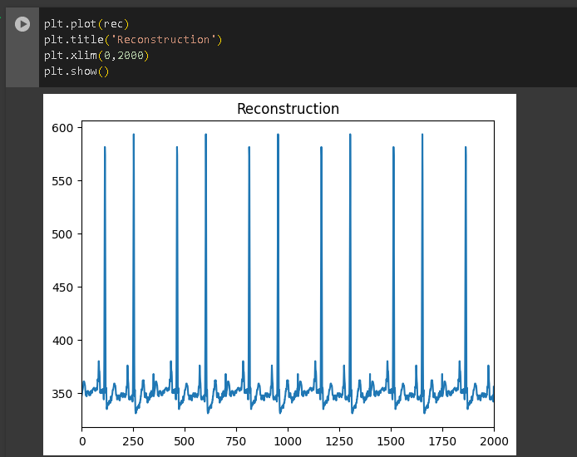

Slide 51
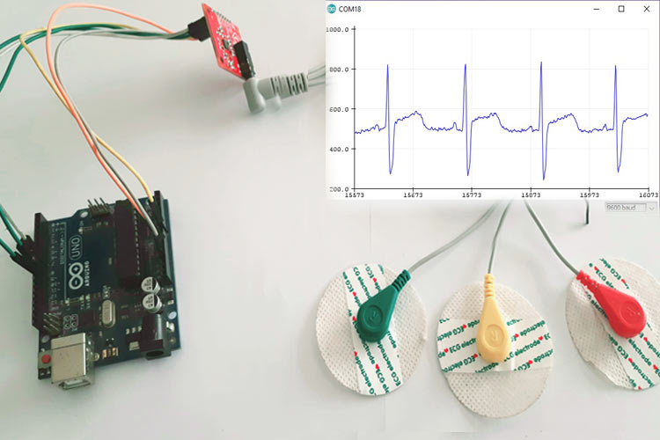
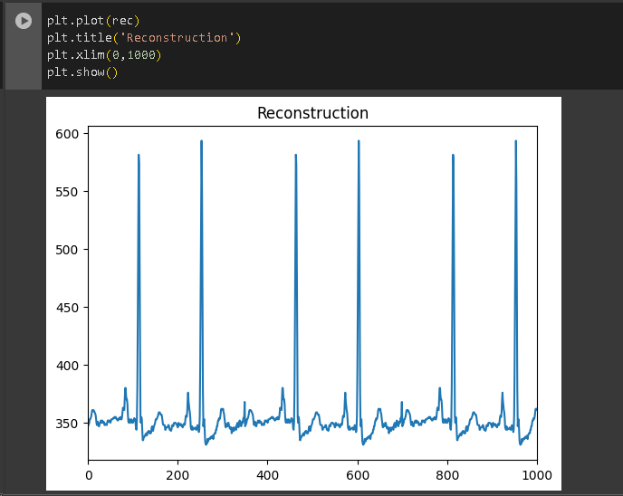
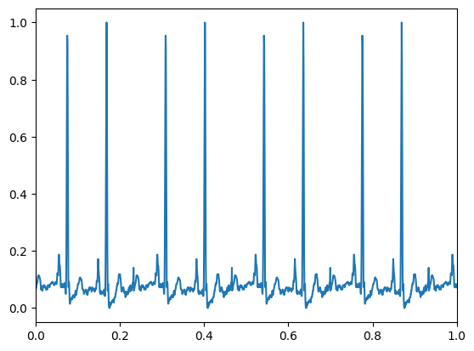
HARDWARE SETUP

Slide 52
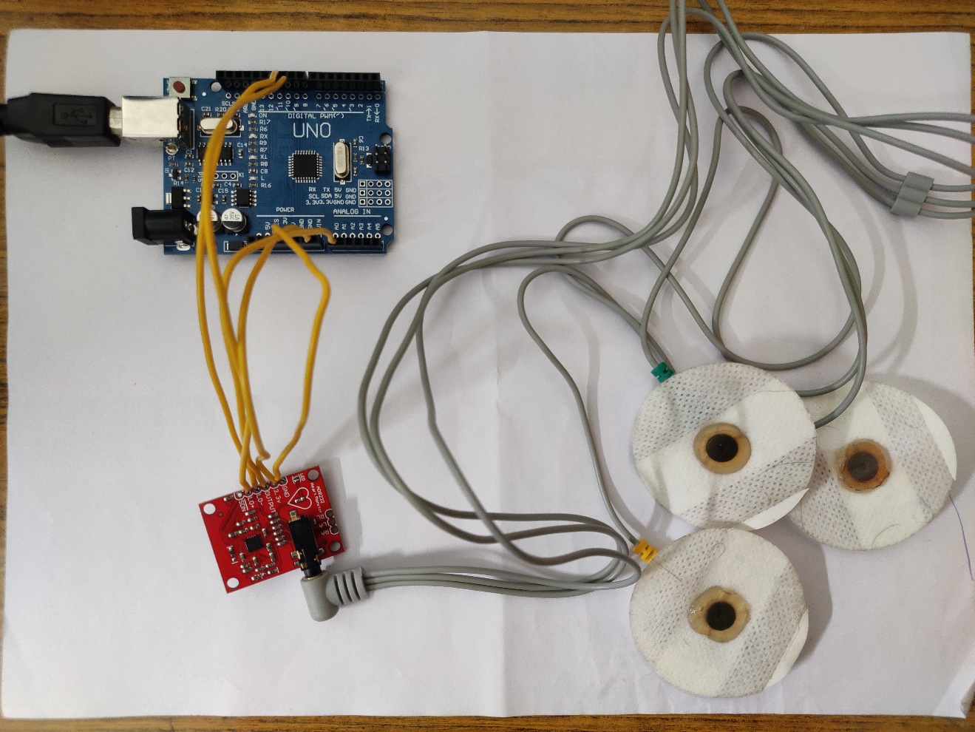
HARDWARE SETUP

Slide 53
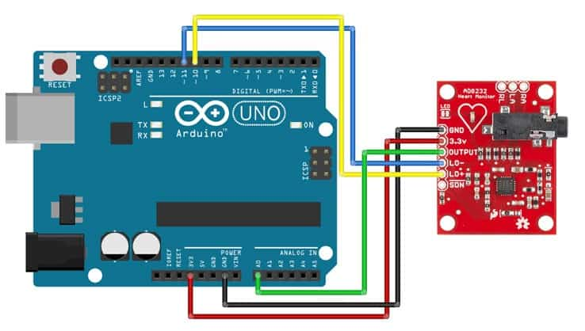
CIRCUIT DESIGN
ARDUINO UNO
AD8232
HEART MONITOR
Department of IT

Slide 54
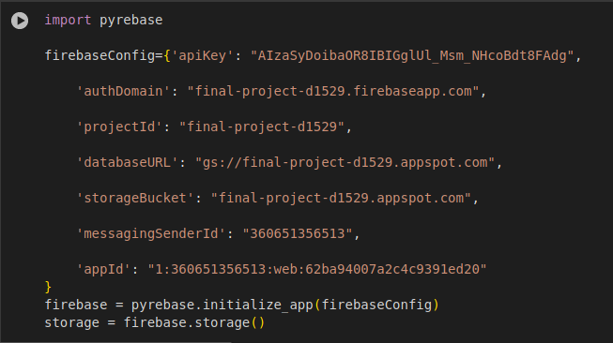
FIREBASE API

Slide 55
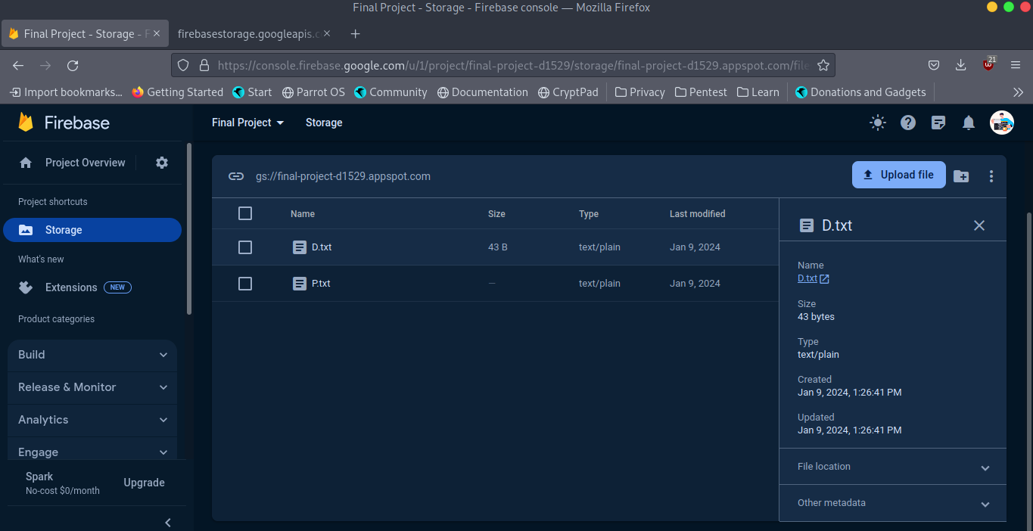
FIREBASE STORAGE

Slide 56
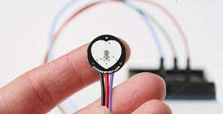
HARDWARE SETUP
PPG SIGNAL SENSOR

Slide 57
SWOT ANALYSIS
STRENGTH:
Secret bit insertion enhances privacy, while HOA and LSTM+MLPNN improve lost data recovery
Integration of Hermite domain technique and Hippopotamus Optimization addresses data loss and ensures information integrity.
WEAKNESS:
Complexity in implementation and integration of multiple techniques may pose challenges in system development.

Slide 58
SWOT ANALYSIS
OPPORTUNITY:
Cost-effective implementation of the proposed framework can improve accessibility to secure communication in healthcare.
Collaboration with healthcare institutions can facilitate real-world testing and refinement of the system, enhancing its practical applicability.
THREATS:
Regulatory compliance and privacy concerns may pose barriers to adoption and implementation in healthcare settings.

Slide 59
SOCIAL IMPACTS
Cost-effective implementation can improve access to secure healthcare communication, potentially reducing healthcare costs.
Enhanced data protection and analysis capabilities contribute to improved patient privacy and better healthcare outcomes.
Implementation in healthcare institutions can streamline data management processes, reducing administrative burdens and improving efficiency.

Slide 60
CONCLUSION
Our research presents a significant advance in secure ECG biosignal transmission, using deep learning for encryption and decryption. The Hermite function ensures data integrity, while hash functions strengthen security. Predictive modeling with MLPNN enhances reliability, and exploring optimization techniques is crucial for future improvements.

Slide 61
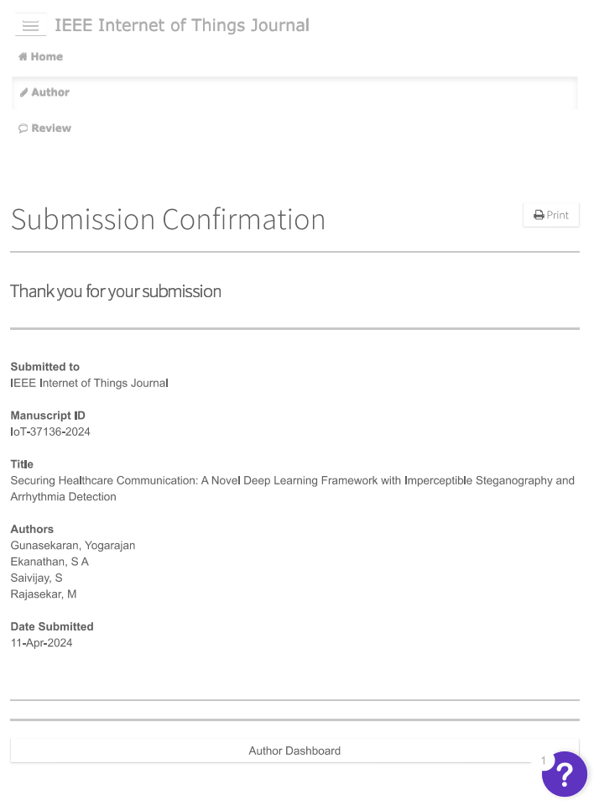
JOURNAL SUBMISSION PROOF IEEE Internet Of Things

Slide 62
References
[1] S. Arunkumar, V. Subramaniyaswamy, V. Vijayakumar, N. Chilamkurti, and R. Logesh, “SVD-based robust image steganographic scheme using RIWT and DCT for secure transmission of medical images,” Measurement, vol. 139, pp. 426–437, Jun. 2019.
[2] M. Khari, A. K. Garg, A. H. Gandomi, R. Gupta, R. Patan, and B. Balusamy, “Securing data in Internet of Things (IoT) using cryptography and steganography techniques,” IEEE Trans. Syst., Man, Cybern., Syst., vol. 50, no. 1, pp. 73–80, Jan. 2020.
[3] S. Banerjee and G. K. Singh, “Deep neural network based missing data prediction of electrocardiogram signal using multiagent reinforcement learning,” Biomed. Signal Process. Control, vol. 67, May 2021, Art. no. 102508.
[4] S. E. Jero, P. Ramu, and S. Ramakrishnan, “Discrete wavelet transform and singular value decomposition based ECG steganography for secured patient information transmission,” J. Med. Syst., vol. 38, no. 10, pp. 1–11, Oct. 2014.

Slide 63
References
[5] J. T. L. Philjon and N. V. Rao, “Metamorphic cryptography—A paradox between cryptography and steganography using dynamic encryption,” in Proc. Int. Conf. Recent Trends Inf. Technol., Jun. 2011, pp. 217–222.
[6] A. Ibaida and I. Khalil, “Wavelet-based ECG steganography for protecting patient confidential information in point-of-care systems,” IEEE Trans. Biomed. Eng., vol. 60, no. 12, pp. 3322–3330, Dec. 2013
[7] N. Soni, I. Saini, and B. Singh, “An integer wavelet transform and pixel value differencing based feature specific hybrid technique for 2D ECG steganography with high payload capacity,” Multim. Tools Appl., vol. 80, pp. 8505–8540, Mar. 2021.

Slide 64
THANK YOU
Notes:
64

